Slide 1
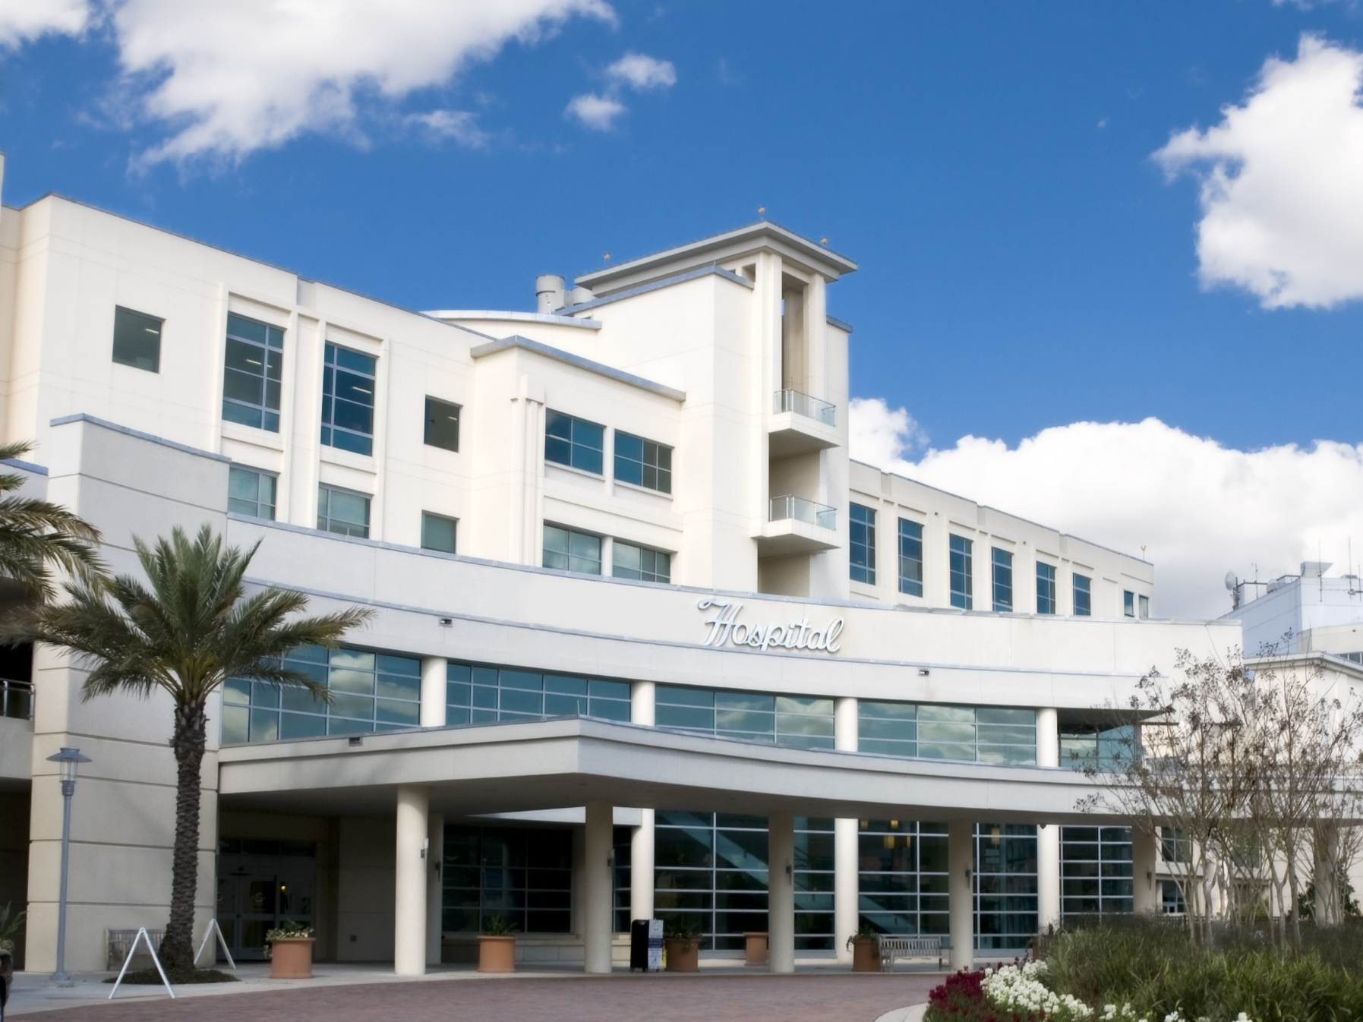

BIRLAMEDISOFT
We Care Health Care…
PRESENTS
QUANTA V3.0 HOSPITAL
INFORMATION
MANAGEMENT
SYSTEM
www.birlamedisoft.com

Slide 2

Birlamedisoft Company Profile
Organization: An ISO 9001:2008 & ISO 27001:2013 certified and a Dedicated Healthcare Software Development Company since 2001.
Promoters: Dr. Upma Birla, MS (Obst & Gynae) & Mr. Shrinivas Birla.
Location: Pune ( Headquarters), India
Managing Director : Dr. Upma Jain
CEO: Mr. Shrinivas Birla
Team: 150 +
www.birlamedisoft.com

Slide 3

Cont…
Vision: To make Software that is usable, comprehensible and affordable to the most ordinary healthcare professional, running a small to big practice anywhere in the World.
Mission: To make Birlamedisoft a ubiquitous Healthcare software brand that is synonymous with the best in Quality and the most Useful of Healthcare software programs
www.birlamedisoft.com

Slide 4

Cont…
Clients: More than 10500+ small to big satisfied clients spread across India and Abroad.
Experience: More than 15 years of Rigorous Healthcare Software development, Healthcare Consulting, Constant Market research, and Inputs from Healthcare professionals and experts.
www.birlamedisoft.com

Slide 5

Cont…
BM Team: Very potential and A strong team of Medical and Software Professionals with more than 5500+ man-years experience into developing Healthcare solutions and services.
www.birlamedisoft.com

Slide 6

BIRLAMEDISOFT DIVISIONS
SUPER SPECIALITY HOSPITALS
GROUP OF HOSPITALS
HOSPITALS
DIAGNOSTIC CENTERS
PATHOLOGY LABORATORIES
PHARMACIES
BLOODBANKS
CLINICS & OPD
www.birlamedisoft.com

Slide 7

BIRLAMEDISOFT WEBBASED SOFTWARES SERIES
www.quanta-his.com
www.maxim-lis.com
www.maxim-pacs.com
www.netbloodbank.com
www.histopath-lab.com
www.epathlab.com
www.birlahospicon.com
www.birlameditour.com
www.birlamedipro.com
www.birlamedisoft.com

Slide 8
Current Healthcare Scenario
www.birlamedisoft.com

Slide 9



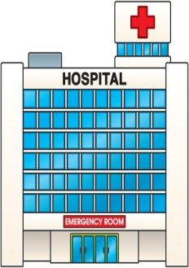



CURRENT PROCESS
2A
DH
1A
PHC
3A
2B
Patient
1B
2C
2D
3C
MCH
3B
2E
Pvt. Clinic
Pvt. Hosp.

Slide 10
Future Healthcare Scenario should be like this via Quanta HIS
www.birlamedisoft.com

Slide 11
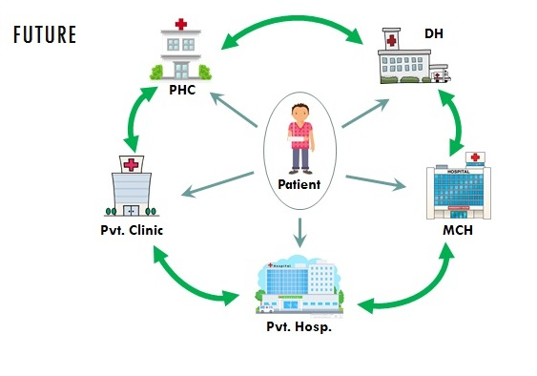

Slide 12
What methodologies would be used
www.birlamedisoft.com

Slide 13
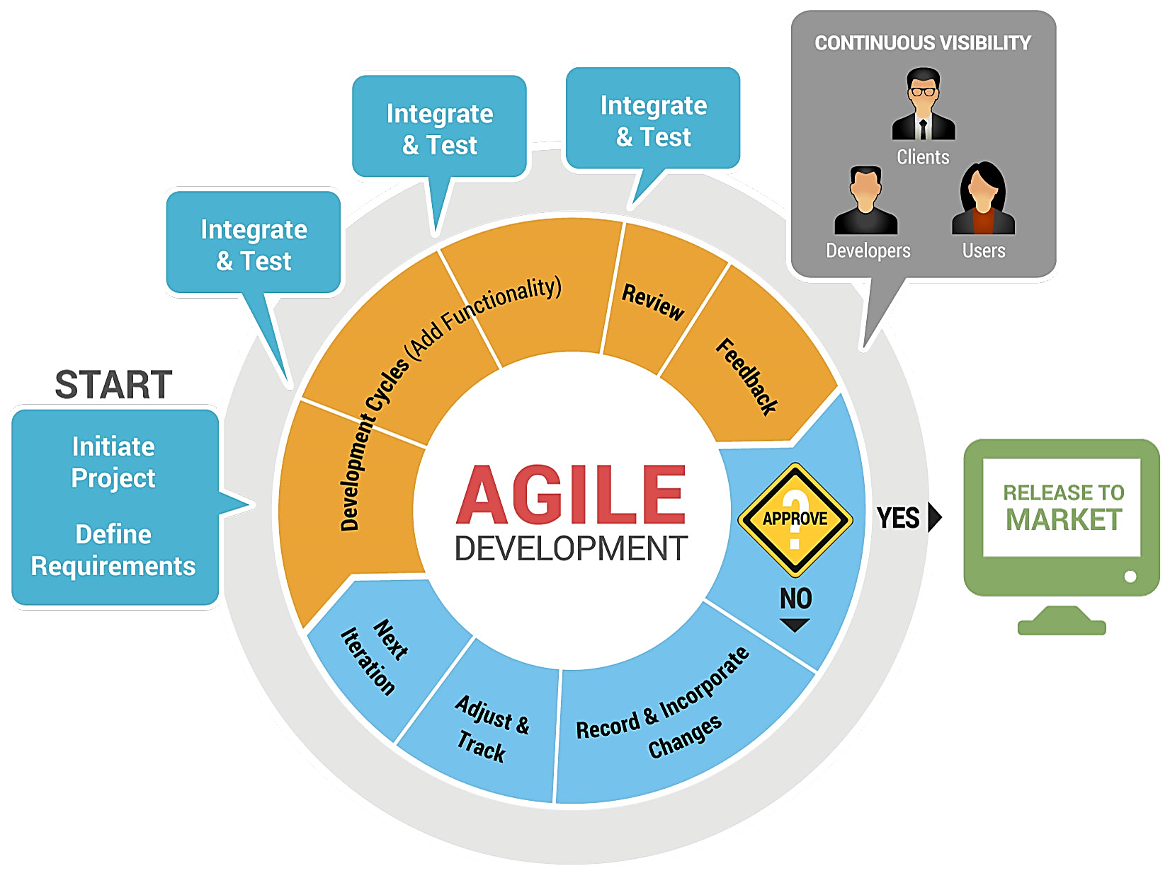
Methodology
Go-Live
www.birlamedisoft.com

Slide 14
All this is possible by Implementing Quanta Healthcare system by Birlamedisoft
www.birlamedisoft.com

Slide 15

BMS Proposes the following solutions ..
Quanta V3.0 WebHIMS
The Complete Web-based Hospital Information Management System
www.birlamedisoft.com

Slide 16
Quanta HIS system
About
Know more
www.birlamedisoft.com

Slide 17
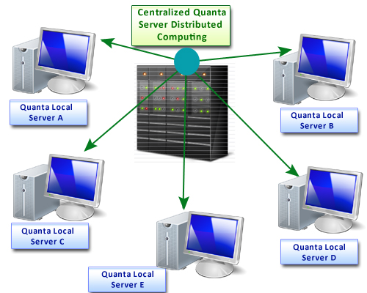
How Hospitals will get connected by Quanta
Quanta Central server at Main Hospital Building and Quanta Local Server at every Clinic location
www.birlamedisoft.com

Slide 18
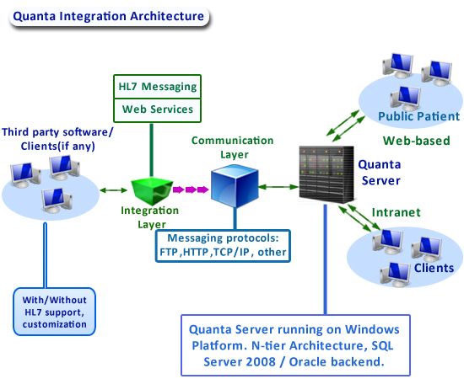
Quanta Integration within Hospital
www.birlamedisoft.com

Slide 19
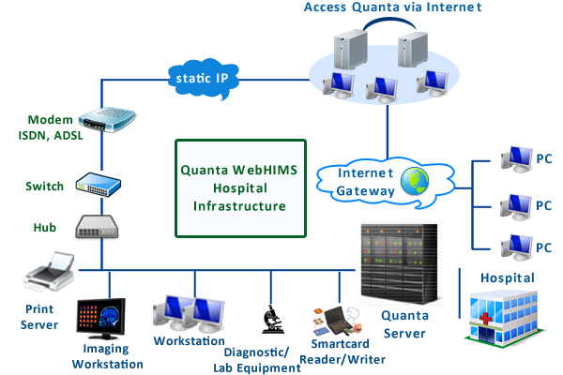
Access Quanta from Outside via Internet
www.birlamedisoft.com

Slide 20
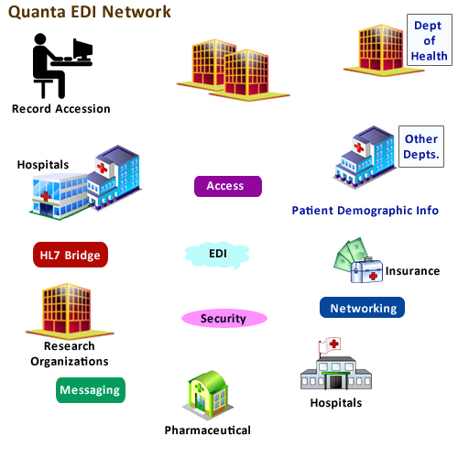
How Quanta will connect with other Govt. departments
www.birlamedisoft.com

Slide 21
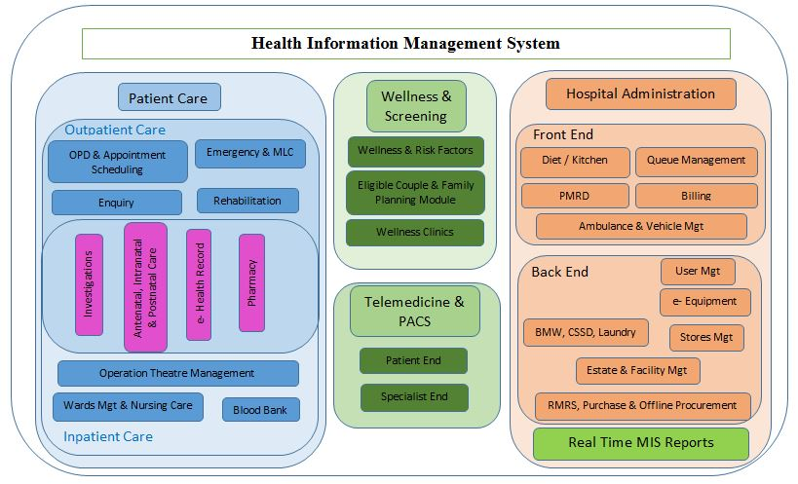
By Implementing QUANTA
Integrated Hospital Management System
www.birlamedisoft.com

Slide 22
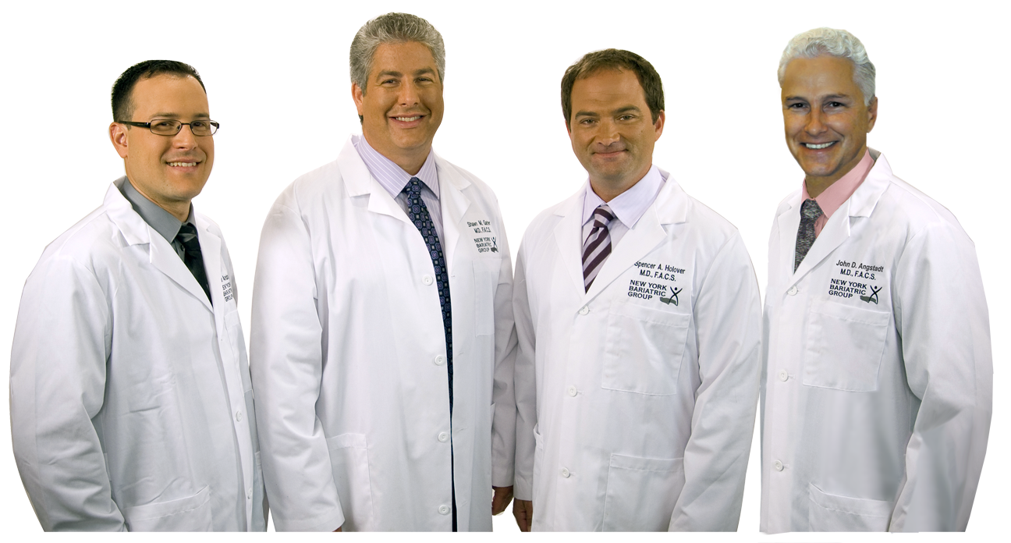
Stakeholders in Healthcare
All types of hospitals like multi-specialty, super-specialty, govt. hospitals, rural hospitals, small private hospitals and medical colleges are the stakeholders in healthcare
Stakeholders also include all clinics like multi-specialty and rehab clinics, nursing homes, blood banks, pharmacies, general practitioners, diagnostic centres. Not to forget the medical insurers and regulators
www.birlamedisoft.com

Slide 23

Features of Quanta
Wow!! Great features!!
Powerful inbuilt Business Intelligence engine
Graphical MIS, using dashboards and graphs
Finest quality GUI by DevExpress
Multi-location connectivity branches ready
Portability on SQL-server, Oracle database
www.birlamedisoft.com

Slide 24




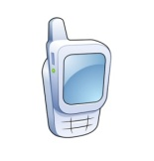















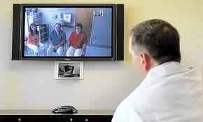


Solution Landscape
Kiosk
Clinical
Research
Centre
Public
Report
Mobile
Inter-
net
Physician
Regulator
Corporate
Centre
Management
Staff
Management
Laptop
Query
Server
Supplier / Company
Staff
Internet
Desktop
Hospital
Diagnostic
Centre
Clinic
Pharmacy
Telemedicine
www.birlamedisoft.com

Slide 25





Solution Coverage
National Reporting/ Statistics (Dashboard)
External
Systems
Central Laboratory
Citizen database
Main data center
Govt. Blood bank
Pharmacy distribution
PHC
General Hospital
Govt. Hospital
www.birlamedisoft.com

Slide 26
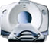
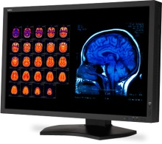





Health Solutions Available
HMS
RIS
PACS
LIS
Clinic
Mgmt
Health Solutions
Telemedicine
Specialized
modules
Pharmacy
Mgmt
Financial
Costing
www.birlamedisoft.com

Slide 27

Objectives of Hospital Computerization
The aim is to achieve the WHO Millennium Development Goals:
Addressing maternal health issues
- Addressing child health issues
Yes, also
- Management of all information
regarding the hospital and
- Combating communicable & non-communicable diseases
www.birlamedisoft.com

Slide 28




Public Health Solutions
Government Health Portal
Health Clinics
Specialty Clinics
Health Info
Main Data Centre
General Hospitals
Specialty Hospitals
Government Hospitals
Labs
www.birlamedisoft.com

Slide 29


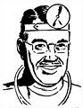



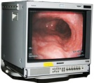

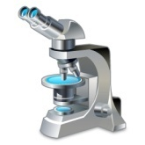

Telemedicine Solutions
Satellite
Rural/District Hospital
Specialty Hospital
Doctor
Specialist
Consultant
doctor
Video Conferencing
Video Conferencing
Lab report
www.birlamedisoft.com

Slide 30

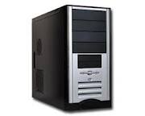
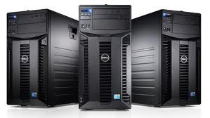

Technology Stack
User Interface & Client
Web Browsers : IE, Mozilla Firefox, Google Chrome, Safari, etc.
Operating System: Windows
Application Server
DotNET Framework, AJAX Development Toolkit, Web Services, WCF Services, IIS
Back-End (Database Server)
SQL Server 2008/Oracle
Hardware
Intel Platform, IBM Series
www.birlamedisoft.com

Slide 31




Interfaces with Standards
See, it is interfaced with standards like ICD-10, HL7 and HIPAA.
www.birlamedisoft.com

Slide 32







Interfaces with Third Party products
It can be interfaced with ERPs like Oracle , SAP, NAVision software, SAGE, MS Dynamics NAV, Tally and Many more
www.birlamedisoft.com

Slide 33
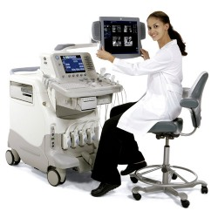
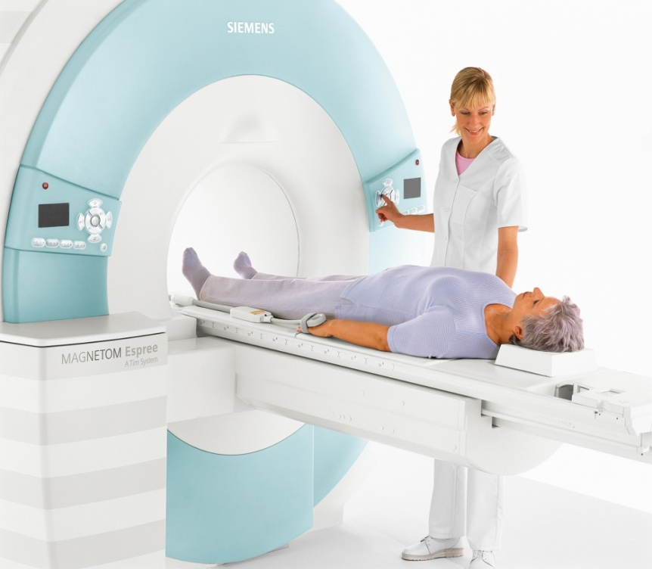
Interfaces with Medical Equipment
It can be interfaced with DICOM equipment
And also with non-DICOM equipment like pathology and imaging devices , both
uni-directional as well as bidirectional …!
www.birlamedisoft.com

Slide 34
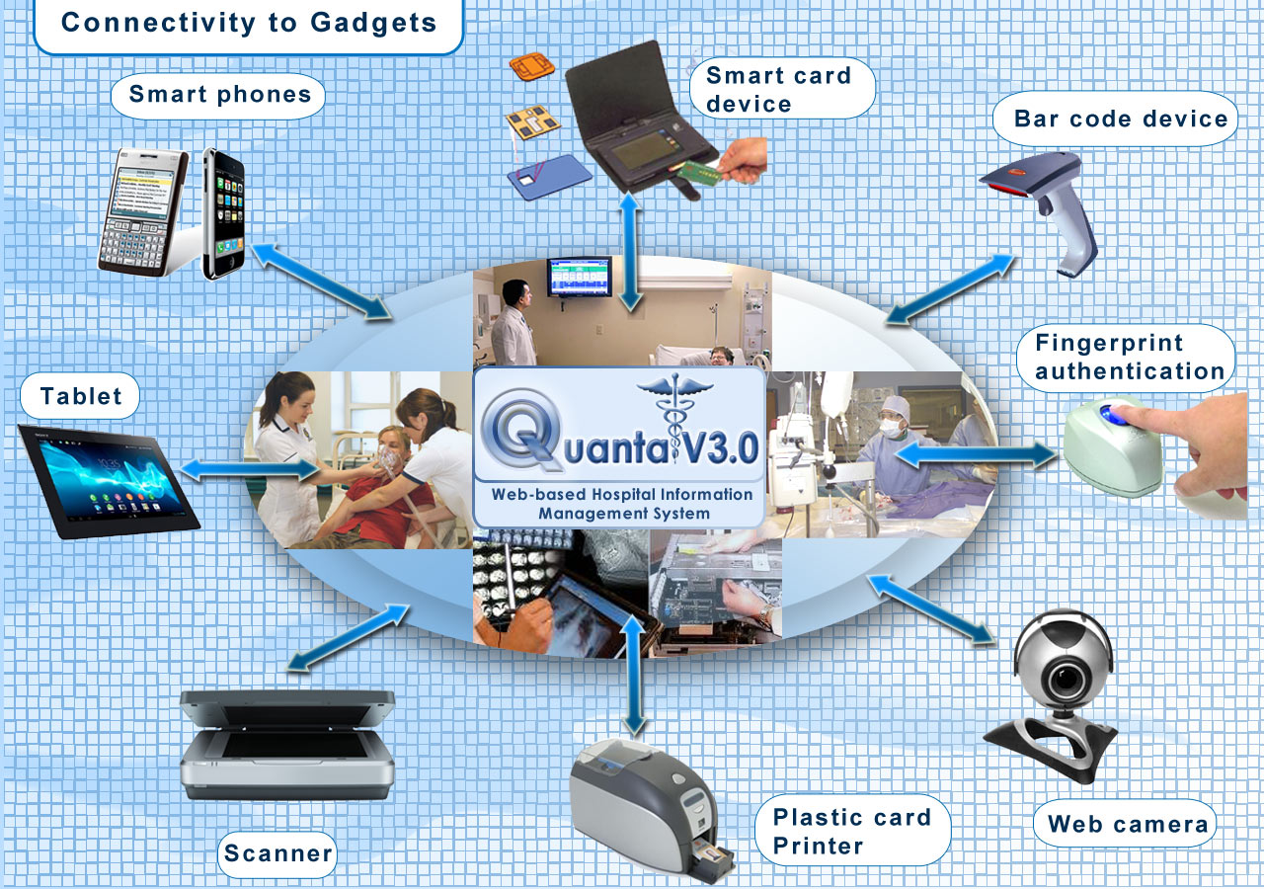
www.birlamedisoft.com

Slide 35





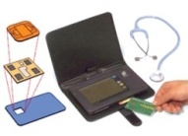








Quanta Smart Link Integration for Insurance Claims Process
Start
Attendant enters claim details on HIMS
Smartlink generates confirmation file
Patient walks into SPs & produces Smart Card
HIMS generates hospitalclaimfile.xml
HIMS checks for confirmation file
SP attendant runs Smart Link & places card on Reader
HIMS inserts transactions into its own database
Attendant goes to Smartlink & selects ‘Retrieve’
Attendant selects the pool & clicks ‘Forward’ button on SL Dbase
Smartlink opens the claim screen with present interim claims
HIMS produces paper invoice
Data forwarded to specified location
Attendant closes/minimizes Smartlink
Attendant clicks on ‘Save claims’
HIMS reads forwarded file & populates HIMS interface
Claims inserted into SL Dbase
End
www.birlamedisoft.com

Slide 36
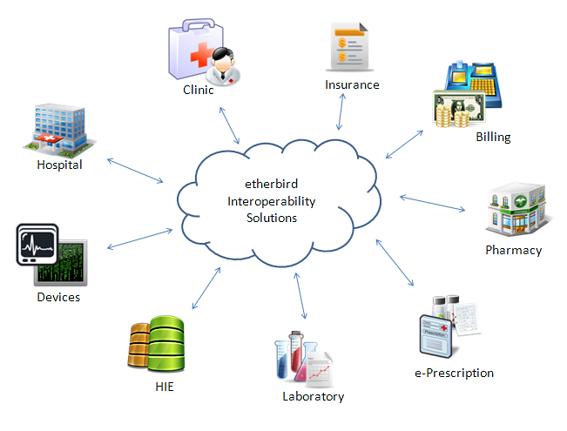
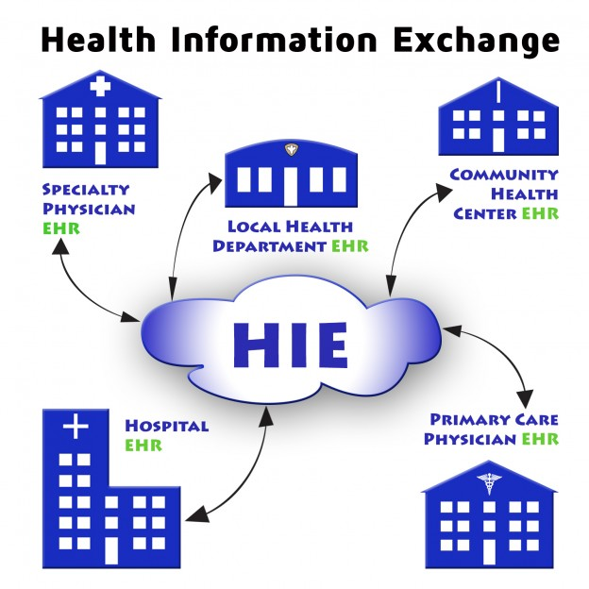
Interfaces/ Inputs
e-Registration
Integrated Health Management System
HEALTH DEPARTMENT EHR
& PACS
www.birlamedisoft.com

Slide 37
Quanta Modules
PATIENT REGISTRATION
WARD / ROOM MANAGEMENT
EMERGENCY/ CASUALTY
DOCTORS WORKBENCH
IPD PATIENT MODULE
WEB-PORTAL / ONLINE APPOINTMENT MODULE
RADIOLOGY INFORMATION SYSTEM
LABORATORY INFORMATION SYSTEM
OPERATION THEATER MANAGEMENT
ROSTER MODULE
COMMUNICATION MODULE
INVENTORY & FIXED ASSET
MEDICAL STORE MANAGEMENT
WARD PHARMACY/ INVENTORY MANAGEMENT
CERTIFICATES ISSUE
DIET MODULE
PHYSIOTHERAPY MODULE
PAY ROLL MODULE
FINANCIAL ACCOUNTING MODULE
DENTAL MODULE
BLOOD BANK
MEDICAL RESEARCH
HOUSE KEEPING MODULE
DONATION MODULE
BILLING MODULE
ICD – 10 DIAGNOSIS MODULE
USER MANAGEMENT
ADDRESS DIRECTORY
BACKUP/ RESTORE MODULE
MIS REPORTS
EQUIPMENT MAINTENANCE
CENTRAL STERILIZED SUPPLY DEPARTMENT
ENERGY AUDIT
COSTING
BUDGETS
AMBULANCE MODULE
HELP DESK
FACILITY MANAGEMENT
LIBRARY MANAGEMENT
PACS & TELE RADIOLOGY
TELEMEDICINE
WASTE MANAGEMENT
KITCHEN
EMR MODULE
TRANSPORT
www.birlamedisoft.com

Slide 38

Quanta Module –Patient Registration, OPD - Menus
Quanta HIS module has options like Admin, Insurance, OPD, IPD, Billing, Patient Registration, OT and Reports
The patient registration module contains all patient details , which are used for patient insurance claims processing, registered patients can get a membership card. They are sent updates through email and SMS.
And options like doctor’s appointment, patient registration, billing, insurance, reports and admin are available in the OPD module
www.birlamedisoft.com

Slide 39


Quanta –EMR, IPD & OT Modules - Menus
The EMR module menu has options like patient history, patient examination, diagnosis, ENT examination, dental dept., patient treatment, PAP Smear report, neonatal discharge summary, gynecology and ophthalmology modules
The IPD module menus include ADT, insurance, EMR, billing, patient registration, reports, OT and admin.
The options in OT module are admin, setting operations schedule and OT register.
www.birlamedisoft.com

Slide 40


Quanta – Billing, Insurance Module - Menus
Insurance request, submit patient claim, sanction insurance, payment received, ledger transaction reports, and admin menus are present in the insurance module
The billing module menus consists of menus such as OPD and IPD billing, IPD advance billing, IPD registration receipt, IPD refund receipt, and admin.
The payment options include credit and debit card , cheque, DD, pay order, cash payment, net banking and mobile payment.
www.birlamedisoft.com

Slide 41



Quanta – Reports, Pathology Module - Menus
The Pathology module consists of inventory, patient registration, accession, patient result menus…
It can also be interfaced with different lab equipment like hematology analyzer, blood gas analyzer, biochemistry analyzer, barcode devices , & many more.
The Reports module consists of reports such as cash report, admitted/ discharged report, different revenue reports, shifted patient, total no. of admissions, refund, MIS, income summary report , & many more.
www.birlamedisoft.com

Slide 42
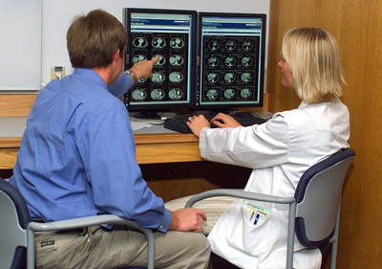

Radiology, PACS Module - Menus
Options such as reports, inventory, patient registration, accession, patient result and admin are available for the radiology module.
The PACS module has a very large number of imaging controls. It has connectivity with more than 50 PACS modalities like Computed Radiography, Computed tomography, Biomagnetic imaging, Duplex doppler, X-ray angiography and many more…
www.birlamedisoft.com

Slide 43


Patient, Procurement Modules - Menus
The Procurement module has 3 main menus:
Master menu – In this are the following menus: supplier, manufacture company, item, edit/ search item, drug master, set rate type, upload drug list, rate type.
Purchase menu – Add new PO, PO tracking, add new invoice, edit/ search invoice, issue voucher, search issue voucher, view acknowledgement, stock adjustment
Report menu – Stock ledger, current stock & current stock branch wise
Options such as making an appointment, viewing appointments, clinical records, patient home, sending email and SMS are all available in patient module
www.birlamedisoft.com

Slide 44


Pharmacy, Inventory, housekeeping, Nurse, CSSD Modules - Menus
Pharmacy module and inventory module have menus such as master, transaction and report menus.
Housekeeping module has one more menu than these – laundry.
The nurse module has menus such as nurse home, pharmacy, inventory and reports.
The CSSD module has menus such as master, report, transaction and CSSD store.
www.birlamedisoft.com

Slide 45
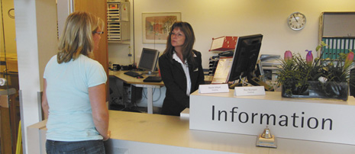

Kitchen, Vehicle Management, User Management, Helpdesk Modules - Menus
Kitchen module has menus such as master, purchase, report, consumption, kitchen and transaction.
Vehicle management module has menus such as vehicle master, ambulance master, ambulance details, assign driver.
User Management module has menus such as employee and admin master.
Helpdesk module has menus like OPD patient list, OPD patient details, lab patient list, IPD patient list, IPD patient details, registered patient list.
Equipment maintenance module has menus such as master, item stock, PM module, work order and work request.
www.birlamedisoft.com

Slide 46
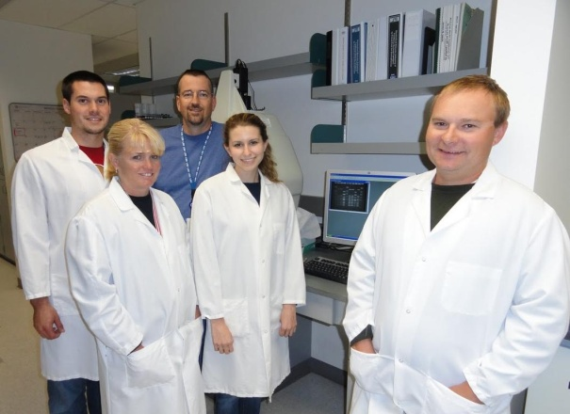

Diet Management , MIS, Roster Management, Payroll, Accounts, Blood bank Modules - Menus
Diet management module has the following menus: diet setting, diet unit master, diet type, meal type, diet scheduler.
MIS module has the following menus:
Chart report, branch/user mgmt., MIS report, add clinic, head office procurement.
Roster management module has the menus: admin, reports and create roster.
Payroll module has the following menus: master, employee transaction, application and reports
Accounts module has menus like master, transaction, budgets, depreciation and reports.
Blood bank module has menus such as blood bank, patient, account, reports, inventory, master, quality maintenance, user management , and camp.
www.birlamedisoft.com

Slide 47

Other Modules
Other modules like address directory, backup & restore, budgets, certificates issue, communication, costing, dental, donation emergency / casualty, energy audit, facility mgmt., ICD-10 diagnosis, library mgmt., medical research, room mgmt., and physiotherapy are also available …
www.birlamedisoft.com

Slide 48
Clients
11 Branches of Ultratech Cement Works, In India are Powered by Quanta HIS
7 branches of Tata Power In India are Powered by Quanta HIS
6 major Govt county Hospitals in Kenya are Powered by Quanta HIS
22 Govt hospitals in Papua New Guinea are powered by Quanta HIS
120+ Big Diagnostics centres around the World are powered by Birlamedisoft Maxim LIS.
5th ranking hospital in Middle East Al Kafeel Hospital, Iraq runs Quanta HIS
550 bed tertiary hospital project building up from ground level in Dhaka, Bangladesh
300 bed New hospital project consulting , Harare, Zimbabwe
Defense Hospital Amanullah Khan Hospital in Afghanistan is powered by Quanta HIS
Medical Aid Society of Malawi (MASMW) is powered by Quanta HIS
Birlamedisoft presence in 15+ countries outside India and growing rapidly
www.birlamedisoft.com

Slide 49

Client Testimonials
"The software is robust and user-friendly. The support centre of Birlamedisoft is very courteous & it provides round-the-clock services for smooth functioning of the software. I am fully satisfied with ‘Quanta WebHIMS’ and recommend the software to other hospitals."
Dr. Hitesh Bhaskar, Director (P&O), Institute of Brain & Spine (Sunflag Hospital), Faridabad
“We are using Birlamedisoft HIS software from the past 6 years with satisfactory performance.”
"The most suitable hospital software at the most reasonable price. We have got what we were looking for."
Narmada Trauma Centre, Bhopal
City Hospital, Jabalpur
"We are proud of having chosen Birlamedisoft Quanta HIS for our organization. This has put us as the number 1 medical organization in our country.”
“Now that we are using this software, all our hospital processes are functioning in a faster and smoother manner"
Medical Aid Society of Malawi (MASM), Malawi
Kitui General Hospital, Kenya
www.birlamedisoft.com

Slide 50

Client Testimonials (contd.)
“One of the best and most useful hospital software we have come across, Birlamedisoft's software has improved the functioning of Cosmo Hospital"
"We are really impressed with the working of Birlamedisoft! Their Quanta HIS software has completely swept away all competition”
Tata Power, Mumbai
Olkalau Hospital, Kenya
"Not only Quanta HIS software, but also the team of Birlamedisoft is one of the best we have encountered. Hats off to Birlamedisoft!”
“Incredible hospital software! It really is second to none. The best software and the best price!!"
Green City Hospital, Greater Noida, Delhi
St. John Hospital, Papua New Guinea
www.birlamedisoft.com

Slide 51

Client Testimonials (contd.)
"We went in for Quanta HIS software as it offered the best quality of HIS and all required functions needed for our hospital.”
“No other software provides the quality and services provided by Birlamedisoft’s ‘Quanta HIS’ software! Our search for a good hospital management software ended when we found Quanta.”
PKC Hospital, Vashi, Mumbai
MIMHANS, Meerut
"Good industrial hospital software systems are very difficult to find, but we were pleasantly surprised as Birlamedisoft offered us just what we needed in the form of Quanta HIS. A really superior quality software!”
“We are lucky to have got Quanta HIS software for our organization. It is really the top software among the available healthcare solutions!”
Ultratech Cement Works
Humming Health, Nairobi, Kenya
www.birlamedisoft.com

Slide 52



www.birlamedisoft.com

Slide 53
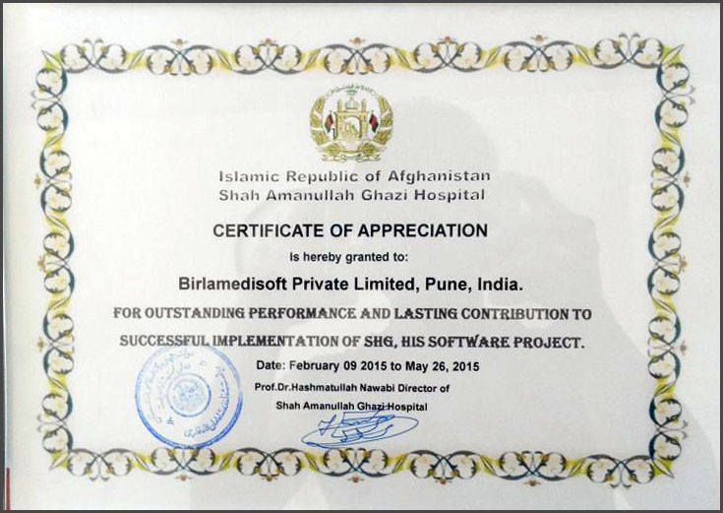
Birlamedisoft Appreciated
Hospital Management System – Quanta V3.0
NDS (Afghanistan)
www.birlamedisoft.com

Slide 54
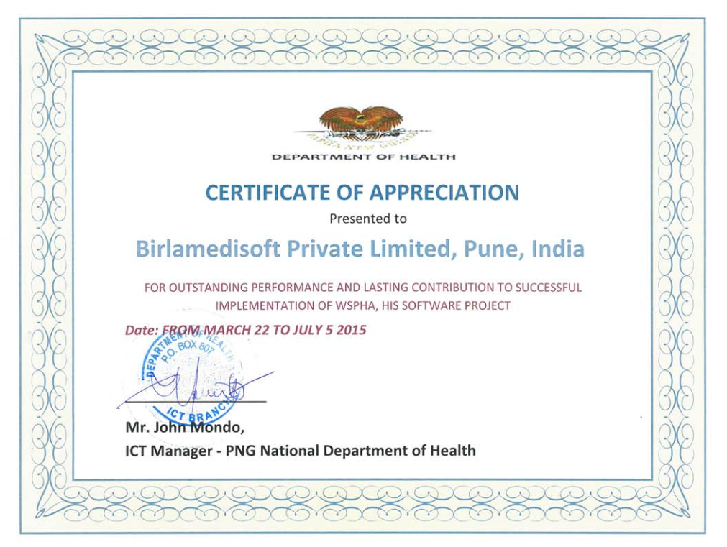
Birlamedisoft Appreciated
Hospital Management System – Quanta V3.0
PNG National Department of Health (Papua New Guinea)
www.birlamedisoft.com

Slide 55
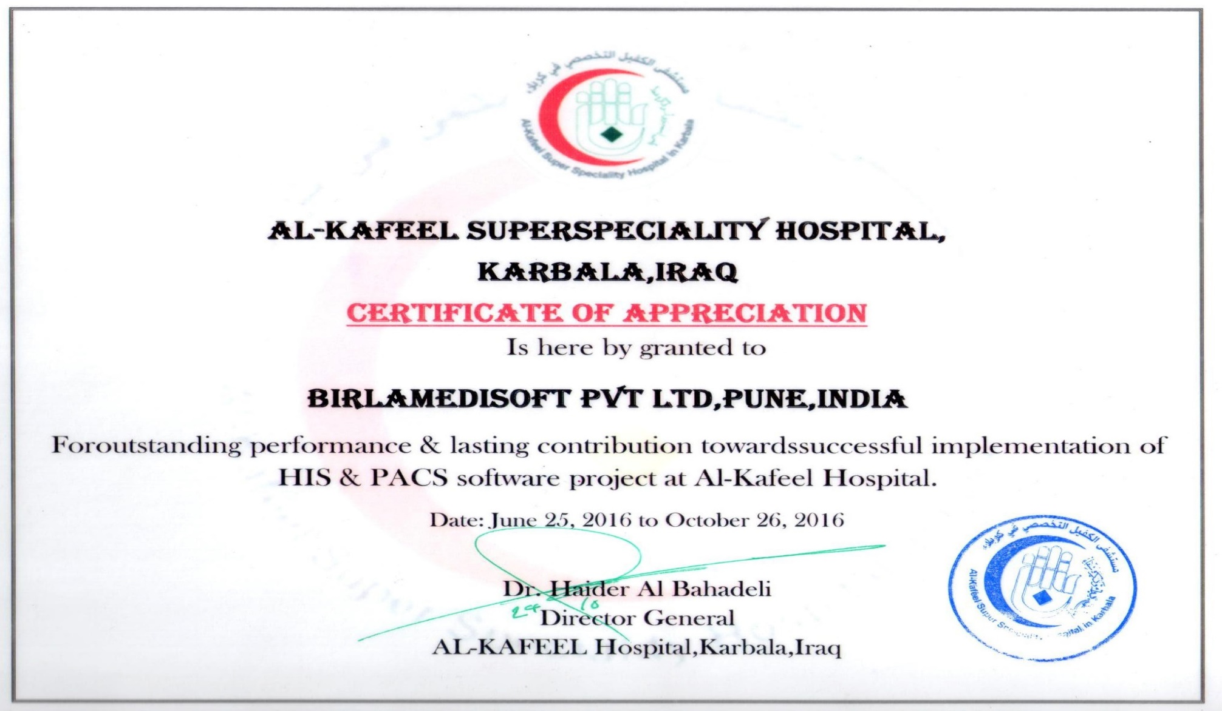
Birlamedisoft Appreciated
Hospital Management System – Quanta V3.0
Al-Kafeel Hospital, Karbala, Iraq
www.birlamedisoft.com

Slide 56
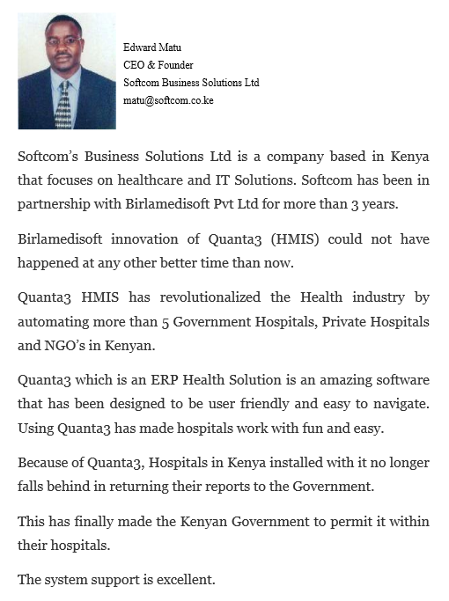
Birlamedisoft Appreciated
Hospital Management System – Quanta V3.0
Softcom Business Solutions Ltd (Kenya)
www.birlamedisoft.com

Slide 57
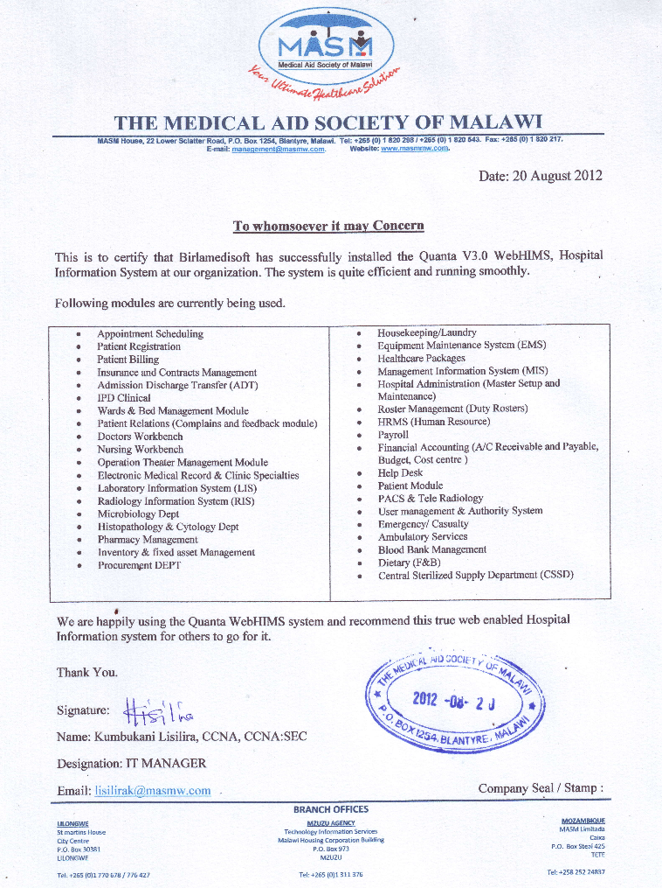
Birlamedisoft Appreciated
Hospital Management System – Quanta V3.0
MASM (Malawi)
www.birlamedisoft.com

Slide 58
Birlamedisoft Appreciated
Check more client reference letters and client list at
http://www.birlamedisoft.com/peer_reviews.html
http://www.birlamedisoft.com/clients-list.html
www.birlamedisoft.com

Slide 59

Birlamedisoft Pvt. Ltd.
We Care Health Care
Mail us at info@birlamedisoft.com
birlamedisoft@gmail.com
Thank You!
www.birlamedisoft.com

